Slide 1


Increase your business value
without having to increase turnover….
Businesses that effectively manage financial crime risks and committed to ethical business practices are generally more successful.
Your business is at risk and is losing money to these financial crime risks – that is a fact. Identify where you are at risk and reduce your losses, thereby increasing the value of your business.

Slide 2
Fraud is committed against individuals, corporate and non-corporate bodies, and local and central government departments.
It is estimated that fraud costs the Global economy as a
whole £3.8 Trillion* each year.
Fraud is still mistakenly seen as a victimless crime.
*ACFE Report to the nation 2022

Slide 3

  What is the financial impact for the Business Sector?
On average what percentage of a businesses revenue is
lost to fraud each year?
1%????
3%????
0.1%??
5% ???

Slide 4
The estimated average percentage business revenue lost to fraud in 2021/22 was 5%
That is £50,000 for every £1m of revenue
Consider what your business could do with a share of that additional money and you quickly realise why it is important to reduce losses to fraud.

Slide 5

Increase your business value
without having to increase turnover….
Business value
Fraud Losses
At its most basic level, reducing fraud losses increases business value.
All businesses from self employed individuals through to large multi-nationals face financial crime risks whether from: theft; fraud; bribery and corruption, or money laundering.

Slide 6
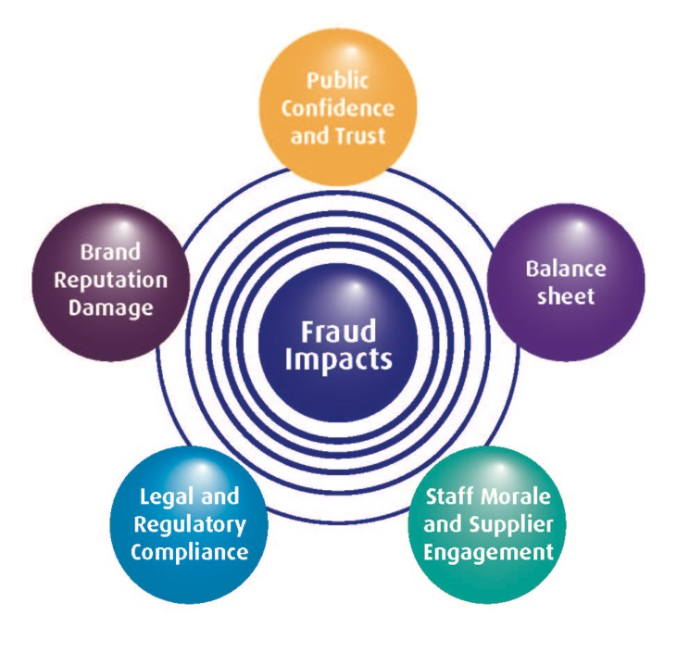
In addition to the financial consequences fraud can adversely impact the business in a number of key ways

Slide 7
In addition to business impacts fraud adversely impacts people, their communities and the world around us
Fraud Bribery Corruption
Organised Crime
Terrorism
Personal Addictions
people trafficking
Terror attacks
drug dealing
violent crime
petty crime
people's livelihoods
Funds
Impacts

Slide 8


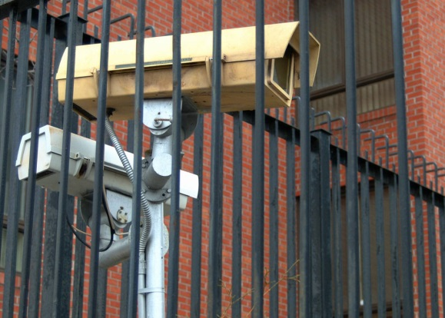


Securing Your Assets
Most businesses wouldn’t dream of doing without some form of physical security to protect their assets.

Slide 9
The reality is that someone can steal your money without coming anywhere near your premises.
Ordering goods or services over the internet; on-line banking; smart phones, and greater use of mobile technologies, amongst other things have all increased the risk from fraud.
As well as internal fraud the above advances in particular mean that businesses of all sizes are also at risk from fraudsters external to the organisation. This means that even sole traders with no employees still need to be aware of and manage the risk of fraud.

Slide 10
Reduce your visibility as a target for fraud
It would be nice to think that we could protect ourselves completely from becoming a victim of financial crime, whether as an individual or as a business. The reality is we can’t because there is too much money to be made by criminals for them to simply shut up shop and go away. We can however reduce our visibility as a target for fraud thus reducing our losses from fraud to an absolute minimum.
Using our Fraud Management Resource Centre cannot therefore offer any guarantees that you will not become the victim of fraud, but it can help you keep your losses as low as possible.

Slide 11

Engage With The Honest Majority
The majority of staff, customers and suppliers are honest but we know that there are a dishonest minority who can cause serious problems and prevent us from achieving our business goals.
You therefore need to engage with that honest majority in order to tackle the dishonest minority.
The approach in our Fraud Management Resource Centre emphasises the need to move to a more proactive approach to fraud risk management through the prevention and deterrence of fraud. The approach acknowledges however that incidents of fraud will still occur and those incidents need to be dealt with in a robust and professional manner.

Slide 12

An Holistic Approach
Our Fraud Management Resource Centre sets out a simple approach divided across three sections which combine together to form an holistic approach to the management of fraud risks.
Prevent
Respond
It is not intended for this strategy to build a new fraud initiative or ‘industry’ but for fraud management to become an explicit element in how you go about day to day business.
Deter
Business principles which provide a commitment to operate professionally, fairly, honestly and with integrity are principles that are at the heart of this fraud strategy.

Slide 13
An Holistic Approach
Each section of our unique guide contains a number of elements with a step by step guide through each one. It is not necessary to fully complete each element in turn but rather each element and section can be developed in unison according to your needs.
Prevent
Deter
Respond
Ensuring there is a clear strategy and policy aligned to the delivery of business objectives, with strong executive support and an understanding of the nature and extent of the risks with proportionate resources available to tackle the problem
Proactive work to create an anti-fraud culture, designing fraud out of systems, deterring fraudsters through communication of a robust anti-fraud stance, and ensuring that the people we employ and do business with share our values of honesty and integrity
Proactive detection of fraud and effective whistleblowing procedures, ensuring suspicions of fraud are quickly and appropriately dealt with and the root cause of any frauds identified with action plans to address identified system/process weaknesses

Slide 14


@fmrc_enquiry
www.facebook.com/fraudmanagement
www.linkedin.com/company/15086985
www.fraudmanagementresourcecentre.co.uk
Enquiry@fraudmanagementresourcecentre.co.uk

