Slide 1



The fraudster in us all
Or putting it another way
Why people commit fraud..

Slide 2
Supporting our Business Priorities
Effective management of fraud risk and reducing our losses to fraud underpins the successful achievement of business priorities by increasing business value.
At its most basic level, reducing fraud losses increases business value.
Business value
Fraud Losses

Slide 3
The fraudster in us all
The majority of employees, customers and suppliers are honest but we know that there are a dishonest minority who can cause serious problems and prevent an organisation from achieving its business goals. We therefore need to engage with that honest majority in order to tackle the dishonest minority.
Economic uncertainty and fears over redundancy increase the risk of fraud. That is not to say that everyone facing these challenges will commit fraud, but how managers respond to and deal with peoples’ anxieties, and the way in which decisions are taken and communicated on a day to day basis are important factors in reducing the risk of fraud.

Slide 4
The fraudster in us all
As this module will demonstrate, fraud is not just committed by career criminals, in fact the capacity to commit fraud exists within every one of us. Understanding what drives people to commit fraud is essential if we want to reduce the risk of our organisation becoming a victim of fraud. This is particularly true as an organisation undergoes change.
Notes:
4

Slide 5
If you believe that crimes are committed by hooded youths or gun-toting drugs dealers – think again.
Our image that crimes are committed by stereotypical villains may have more to do with cartoon strips and TV programmes rather than reality. This is particularly true in the case of fraud. There really is no stereotypical fraudster, they come from all walks of life and all ages.

Slide 6
Let us begin by considering some situations you may have found yourself in either at work or at home…..

Slide 7
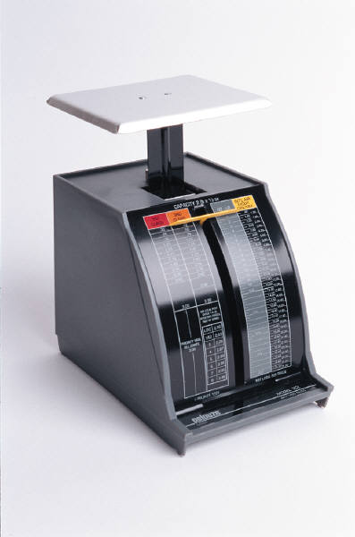
Would you ever put a personal letter through the office mail system?
You could perhaps justify this to yourself – it will save you time so you can get on with some work, its only one letter so where is the harm?

Slide 8

Do you know someone who has been tempted to inflate a personal insurance claim?
So let me run through this again sir......you hit the tree and a branch flew off and dented the rear of the car aswell as the front??????

Slide 9
Do you know someone who has paid cash to a builder to get the job cheaper, knowing they weren’t going to pay the full tax or VAT?
£
We all like a good deal and if we can get the job done cheaper then why should we worry whether the builder pays their taxes – that is a matter for them......
Isn’t it?

Slide 10
If you answered yes to any of these questions, or perhaps faced other similar situations ....
Don’t worry you are not alone.

Slide 11
Many of us will have faced these or similar situations.
Think about the types of situations where you have been faced with a choice of actions and you have chosen a particular response even though you know it is wrong.
Notes:
11

Slide 12
According to research by Keele University, petty crime even amongst the middle classes is rife.
A study carried out in June 2007 by Professor Susanne Karstedt and Dr Stephen Farrall, indicated that some 61% had committed a crime against their employer, the government, or a business.
Those questioned admitted the following:
This table demonstrates that people may have a different attitude to fraud than to other crimes. It is often viewed as a victimless crime. If you or a friend or relative has ever had their credit card cloned then you will be aware that fraud is far from being a victimless crime. We all pay for fraud through higher taxes, higher insurance premiums, and higher bank charges.
Paid cash-in-hand to avoid tax | 34%
Kept cash when ‘over-changed’ | 32%
Stolen something from work | 18%
Avoided paying TV licence | 11%
Padded out an insurance claim | 7%
Asked a bureaucrat friend to ‘bend the rules’ | 6%
Misclaimed state benefits | 3%
_{[Source: Keele University]}

Slide 13
In a separate survey by Leicester University, 70% of the 2,000 people questioned admitted they would commit fraud, if they thought they would get away with it.

Slide 14
The Fraud Triangle
Opportunity
Rationalisation
Motive
Click on a point of the triangle to learn more
Fraud
Motive + Opportunity + Rationalisation = Fraud
Notes:
14

Slide 15
The Fraud Triangle
Opportunity
Rationalisation
Motive
Perceived Opportunity – For example weak management or a loophole in financial controls
Fraud
Motive + Opportunity + Rationalisation = Fraud
Click on a point of the triangle to learn more
Click here when you have finished exploring the fraud triangle
Notes:
15

Slide 16
The Fraud Triangle
Opportunity
Rationalisation
Motive
Fraud
Rationalisation – essentially the inner monologue justifying the fraudulent action e.g. this is fair or just because they owe me….etc
Motive + Opportunity + Rationalisation = Fraud
Click on a point of the triangle to learn more
Click here when you have finished exploring the fraud triangle
Notes:
16

Slide 17
The Fraud Triangle
Opportunity
Rationalisation
Motive
Fraud
Motive - An event or condition which produces financial pressure on the potential fraudster
Motive + Opportunity + Rationalisation = Fraud
Click on a point of the triangle to learn more
Click here when you have finished exploring the fraud triangle
Notes:
17

Slide 18
The Fraud Triangle
Opportunity
Rationalisation
Motive
Fraud
Therefore any action that increases motive, opportunity and/or rationalisation, increases fraud risk.
Motive + Opportunity + Rationalisation = Fraud
Notes:
18

Slide 19
The Fraud Triangle
Opportunity
Rationalisation
Motive
Fraud
Conversely take away any one of these three elements and you have reduced the risk of fraud
Motive + Opportunity + Rationalisation = Fraud
Notes:
19

Slide 20
Think now about your own part of the business............
Where could there be opportunities for fraud as a result of weak or poorly applied controls?
How robust is the due diligence process for new commercial relationships and personnel in your organisation?
How robust are the sign-off procedures for Purchase Orders and Invoices?
How robust are the procedures for authorisation of timesheets or overtime?
Could organisational changes reduce your ability to apply existing controls effectively?
Notes:
20

Slide 21
Think now about your own part of the business............
How could someone rationalise committing fraud
against our organisation?
Does your own conduct show that you care about standards and regulations just as much as you expect everyone else to.
Could decisions you take be perceived by some as unfair or unjust?
Do you understand the pressures upon, or morale of, the employees within your department?
Could you be inadvertently giving the message that ‘anything goes’ or that ‘the end justifies the means’ when it comes to generating profit?
Notes:
21

Slide 22
Think now about your own part of the business............
What motives could there be for people to commit fraud
against our organisation?
Could people misrepresent company or team performance to maintain investor confidence or their own lifestyles?
Could individuals whose income or job security is affected by cost-cutting measures seek to reward themselves ‘through the back door’?
Is there significant disparity between remuneration and or rewards
for different teams undertaking similar work?
Notes:
22

Slide 23
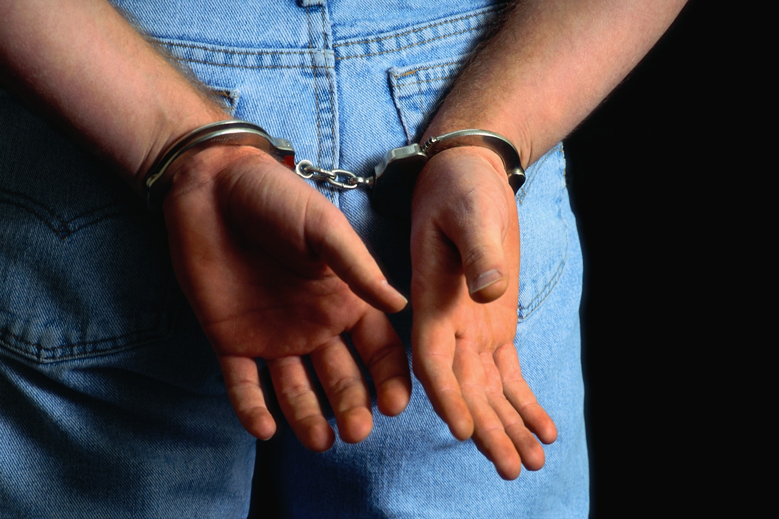
The Fraudsters Perspective on Fraud
If you need proof of the impact of these issues – why not talk to some convicted fraudsters? That is exactly what the Perpetuity Group did and the results provide a useful insight from a different perspective, into why people commit fraud.
Their report was based on interviews with 16 convicted offenders. The main focus was on people who had stolen large sums from organisations with which they were connected (usually those that they were employed by).
Here are some extracts of what those fraudsters had to say…………

Slide 24

The Fraudsters Perspective on Fraud
Rule breaking occurred from the top down
Anything goes was the attitude
I loved the company but did not feel well treated
I was in massive debt
If you’re not honest, don’t be surprised if your employees aren’t
I could have got more stacking shelves at Tesco
Notes:
24

Slide 25
Do whatever it
takes to meet goals
81%
Key Pressures
Do not consider
actions fraudulent
40%
Seek
Personal Gain
72%
The 2007 Oversight Systems Report on Corporate Fraud, www.oversightsystems.com

Slide 26
What can we do as part of developing our Leadership Behaviours?
Remember, employees look to management for direction. Management must be conscious of the signals it is sends to its employees. Creating an ethical tone at the top will cut losses due to fraud and improve loyalty and morale. Preventing fraud is good business, and it starts at the top.
When employees are in a positive work environment, they will be more reluctant to commit fraud that will hurt the organisation. To create and maintain a positive work environment particularly regarding reducing fraud risks, managers should ensure that they:
Lead by example “walk the walk” and lead with integrity
Demonstrate commitment to our business principles through both words and actions
Reward integrity and ensure recognition and reward systems are in tandem with goals and results
• Ensure equal employment opportunities exist
• Encourage team-oriented, collaborative decision-making
Creating a Positive
Environment

Slide 27

STORY OF A CONVICTED CRIMINAL: WALT PAVLO
Walt Pavlo is a convicted criminal who claims that he was pressured by his bosses to commit financial statement fraud at MCI/WorldCom.
In January of 2001, Pavlo received a 41-month prison sentence for money laundering, wire fraud, and obstruction of justice. He was a Senior Manager in Billing Collections at MCI/WorldCom and dealt with customer payments, credits, and reconciliations of accounts. He felt pressure from upper level management at MCI/WorldCom to constantly achieve revenue growth in the company.
Revenue projections for the company were laid out beforehand for each period, and employees were pressured to meet or exceed these projections. As Pavlo watched his bosses manipulate the company’s financial records, he soon began to manipulate them himself. Soon after, Pavlo’s own employees would learn to conduct fraudulent activity under their boss.
Pavlo and his supervisors met to devise ideas on how to cook the company’s books. Financial records were manipulated by Pavlo, his superiors, and his colleagues in a widespread effort to fraudulently make the company look like it was meeting revenue growth projections, even though it wasn’t. Pavlo learned how to conceal uncollectible debt, which boosted the company’s assets and profits.
Auditors eventually found unusual journal entries made by Pavlo and confronted him about it. It was then that he confessed to his fraudulent behavior.

Slide 28
STORY OF A CONVICTED CRIMINAL: WALT PAVLO
Similar to many other people who commit fraud, Pavlo didn’t feel as though he was doing anything wrong in the beginning. He felt that he was doing his job and making his employers happy by altering the company’s financial data. In the long run, he incorrectly thought, the problem would remedy itself.
Even a highly-educated and well-experienced employee can become a fraudster. Pavlo held an Industrial Engineering degree from West Virginia University and an MBA from the Stetson School of Business at Mercer University in Atlanta, Georgia. He left behind his wife and two young sons when he served a two-year prison sentence for his financial crimes.

Slide 29


Anatomy of a Fraud
There were three major factors present in Walt’s case. These factors are also common in many other fraud cases, particularly in larger companies. The fraud factors were:
Pressure to reach goals - The degree of fear and pressure associated with meeting numerical goals and targets also play a major role in fraud. It goes without saying that the more pressure and fear that an employee feels to meet revenue goals, the more likely they are to do whatever it takes to meet those goals. Pavlo stated that he learned how to conceal uncollectible debt and artificially boost the company’s assets and profits from his supervisors . With their help, he delayed write-offs and made the revenue numbers seem more attractive by making them look like they were collectible. Not only was this unethical, it was also illegal.
Compensation and incentives - Compensation and incentive plans may encourage unacceptable, unethical, and illegal conduct. In Pavlo’s case, in addition to his annual salary, he was eligible for thousands of dollars in stock options each year if he was able to meet his financial targets. He knew there was a financial incentive for cooking the books, so he manipulated the numbers. This created a financial gain for him and kept his bosses happy at the same time.
Meeting analysts’ expectations - Upper management and employees can become preoccupied with meeting analysts’ expectations. This preoccupation can lead to the pressure to commit fraud. In the case of Walt Pavlo, he felt extreme pressure from his superiors to meet revenue projections. Employees and executives alike knew where the numbers needed to be in order to meet those projections, and they would meet to discuss different ways to manipulate the records so that it looked like MCI/WorldCom was living up to analysts’ expectations.

Slide 30
The content of this module forms part of a series being developed by Fraud Management Resource Centre about managing the risk of fraud.
Other modules being developed:
What is fraud and what might it look like?
Fraud Proofing policies and processes.
Red Flag warning signs and raising concerns.
Detecting fraud through data analytics – a guide for managers.
A managers guide to responding to incidents of fraud.
Learning the Lessons from Frauds

Slide 31
OR
For more information about this and other courses offered please contact
Fraud Management Resource Centre
Email
Visit
Fraud Management
Resource Centre

